Slide 1

Power BI Training
Advanced
UMB Session 3
Tabular Modeling & Optimization

Slide 2

















Ruben Vadnai Data & AI Consultant
Chicago, IL
Born in Switzerland
Raised in France
Educated in USA
Bridging the Business and the
IT
functions
20+ years in Chicago
15+ years of functional business experience
Marketing, Sales and Operations Management
In Technical, B2B and data-intensive environments
Georgetown University MBA
Career Evolution
10+ years of Business Intelligence, Analytics & Reporting
Data Engineering, Data Modeling & Governance
Enterprise Reporting, Dashboard Design & Data Visualization
Power BI SME
MCSE - Data Management & Analytics
Commodities Trading
International Market Development
B2B Marketing & Sales
Business Strategy Consulting
Corporate Analytics & Reporting
Business Intelligence Development
See profile for more details
Business Planning & Strategy
Marketing & Sales Management
Planning, Budgeting & Forecasting
Channel & Pricing Management
Campaign & Funnel Analytics
Healthcare Services
Internet Services
In-Flight Entertainment
Medical Products
Life Sciences
Commodities Trading
Chemical Manufacturing
Industrial Distribution
Logistics & Supply Chain

Slide 3
Course Objectives
By the end of this course, you will be able to use M to create formulas and calculations in a Power BI Desktop data model. Specifically, you will be able to:
Understand the Power BI Desktop data model, its components and most effective schemas
Describe concepts of calculated columns and measures
Create queries using M
Understand the use of functions
Create and optimize a data model
Understand the consequences of data model design decisions
© 2021 Microsoft All rights reserved.

Slide 4
Course Agenda
Course Agenda
 | Subject | Suggested time
 | Introductions and Overview | 15 min
Module 1 | Getting and shaping the Data | 30 min
Lab 01 | Getting the data | 15 min
Module 2 | Basic Data Modeling | 30 min
Lab 02 | Creating Dimensions, Fact and Shaping the data | 30 min
Module 3 | Getting started with M (Power Query Language) | 30 min
Lab 03 | Creating Relationships | 30 min
Module 4 | Understanding Logic Operators | 30 min
 | Break | 30 min
Module 5 | Calculated Columns vs Calculated Measures | 15 min
Module 6 | Power BI Performance Factors | 45 min
Module 7 | Power BI Modeling Best Practices | 30 min
Lab 7 | Performance Analyzer | 15 min
Module 8 | Development Tool: Tabular Editor | 20 min
© 2021 Microsoft All rights reserved.
Notes:
For online delivery, you have an option to divide the content into 2 days and add the breaks accordingly.

Slide 5
Module 1
Advanced
Power BI Training
Getting and Shaping the Data

Slide 6
Module 1 Objectives
Advanced
Get & Shape
Data
Power BI
Training
Understand what is meant by data model in the context of Power BI
Understand the consequences of data model design decisions
Understand consequences of Power BI’s data type handling
Understand data connection options

Slide 7
Module 1
Advanced
Power BI Training
Demonstration

Slide 8
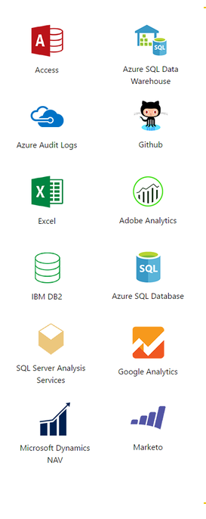

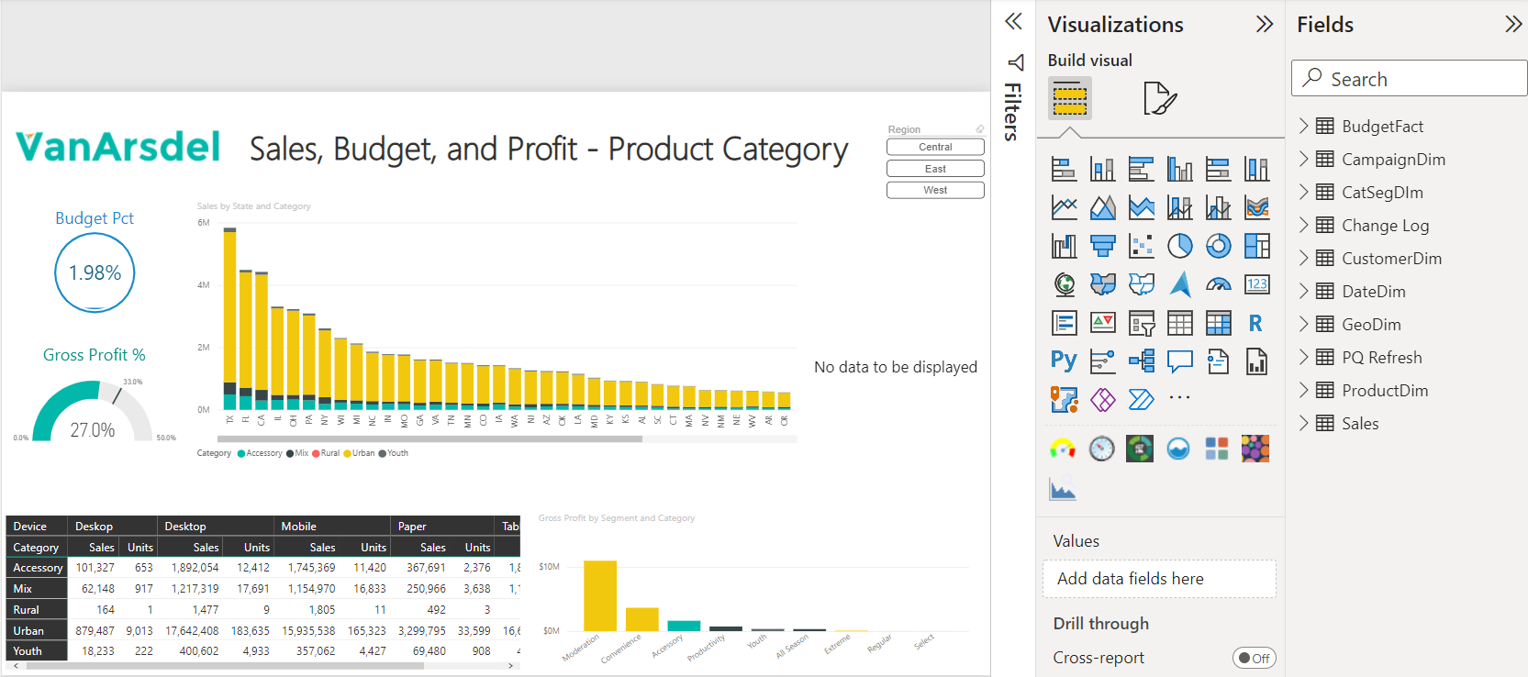
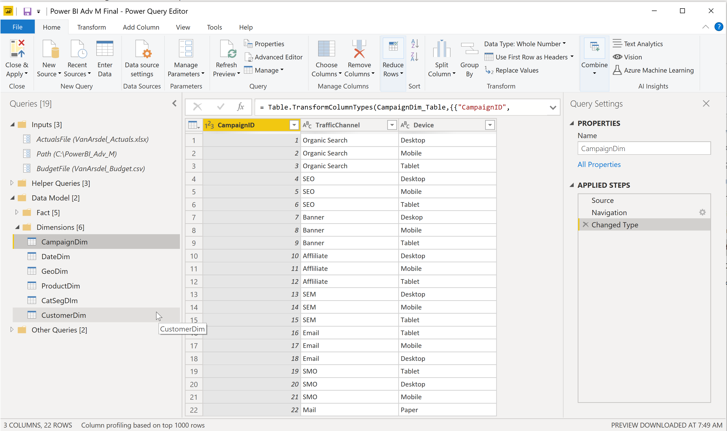

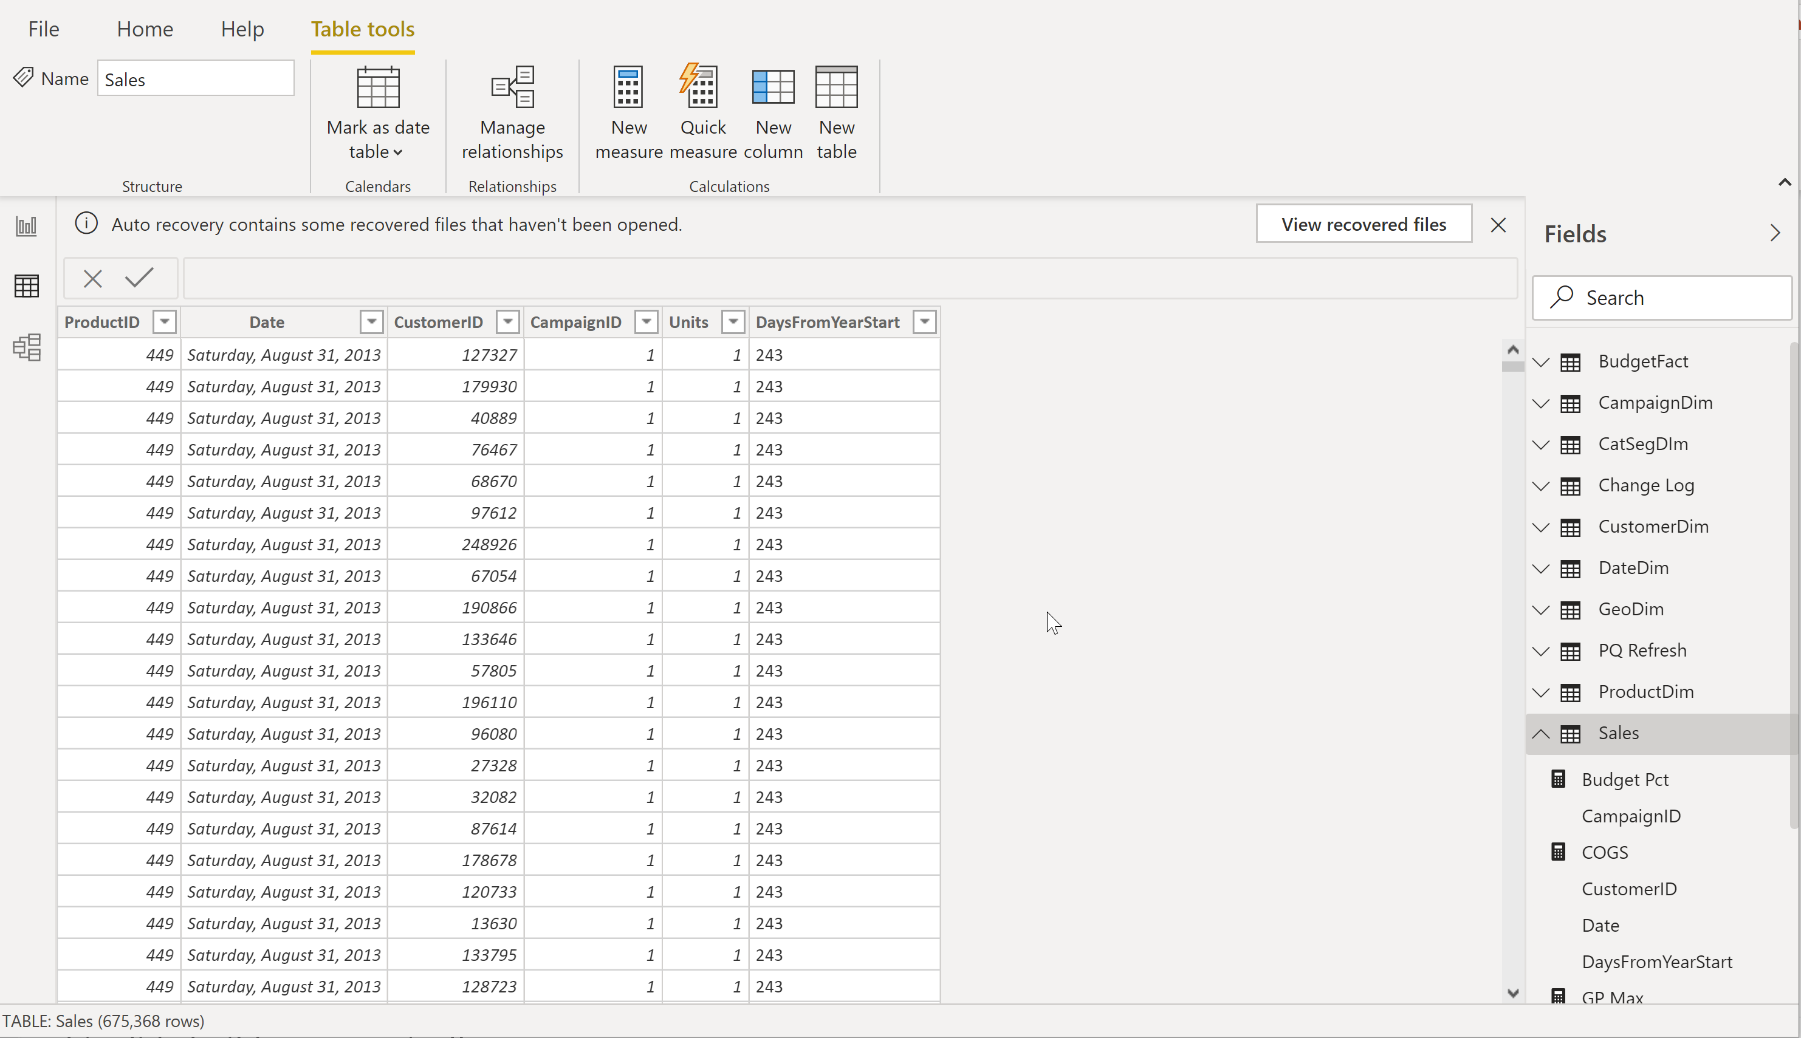

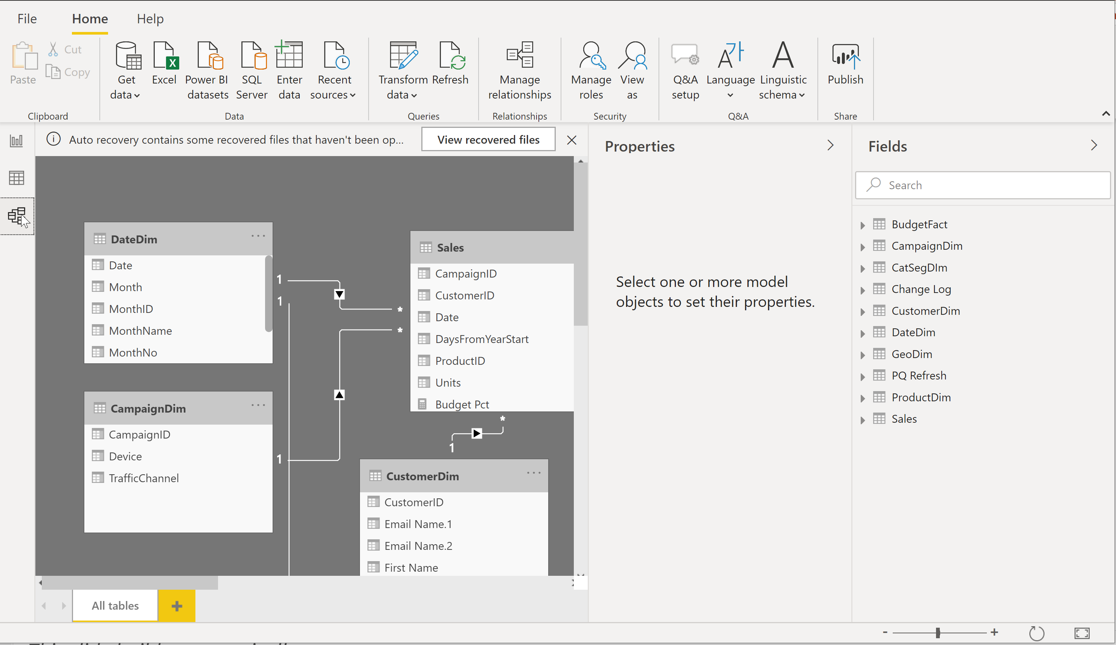
Power BI Desktop Workflow
Power BI Desktop - .PBIX file
Report
Create Visual
Data Sources
Close & Apply
Data
View imported data
& DAX tables
Query Editor
Data Source Connections
Data Transformation
Close
Closes Query Editor
Relationships
View & manage table relationships
Apply
Loads data to Model

Slide 9

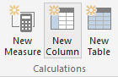
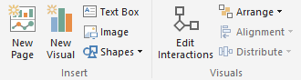
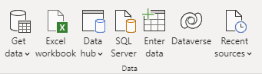
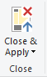
Power BI Desktop Development
4 Phases in Building a Power BI Desktop File
Get Data
Model
Creation
Model
Enhancement
Visual Building
Create query in “M”
ETL Process
Data compression
Relationships detection
Local date tables creation
Calculated columns
Measures
Missing relationships
Create Local & DAX Tables
Evaluate measures and build visuals

Slide 10
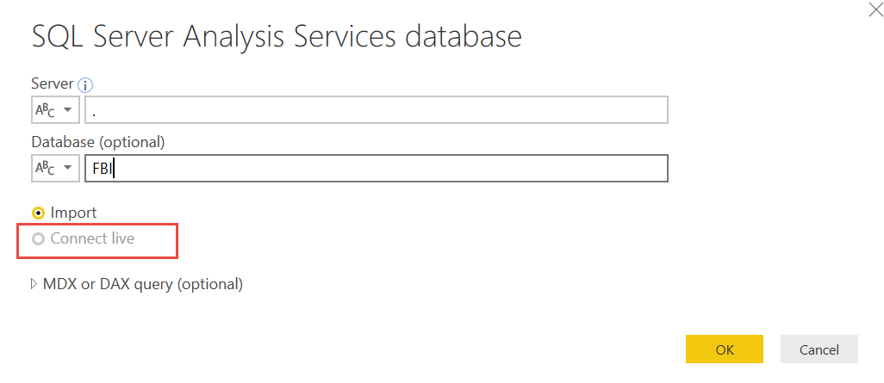
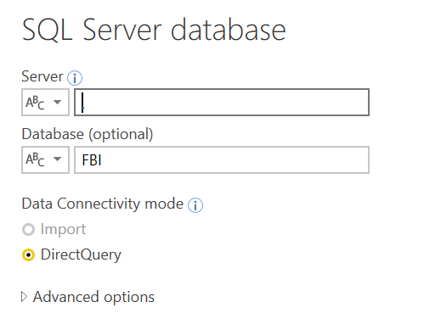
Getting the data - Data Connection
Getting the data - Data Connection
Power BI data has two types of connections:
Import data
Connect to a data source and import directly to the .pbix file
Data cached in-memory
Live connect
Direct query to a database
Both connections can be used from various on premise or cloud data sources

Slide 11
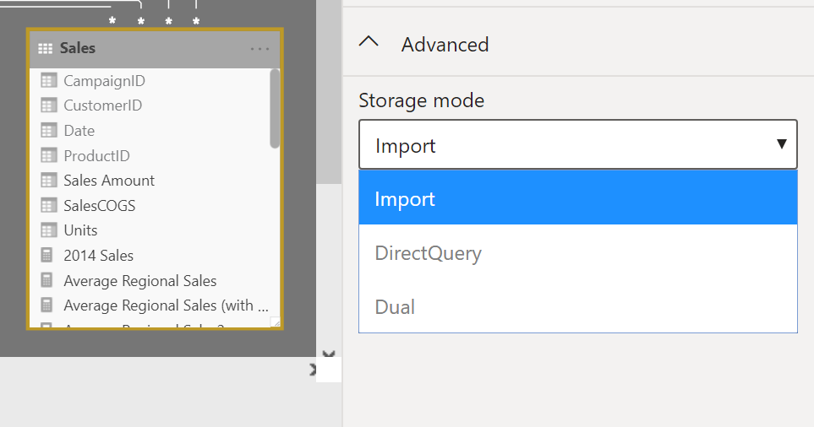
Getting the data - Data Storage Mode
Getting the data - Data Connection
Three different types of data storage modes can be specified for every tables
Import Mode
Import data into Power BI (creates a copy of the data)
Queries can be fulfilled from cached data
Example: Excel, SharePoint, CSV, OData
Direct Query Mode
Direct query to SQL or other relational source
Executes on demand queries to the data source
Example: Analysis Services Tabular, SQL DW
Dual Mode
Acts as either cached or not cached, depending on query context

Slide 12
Data Import vs DirectQuery Storage Mode
Import Data to Power BI wherever possible to:
Leverage PBI’s high performance query engine (Vertipaq)
Provide a higher performance and highly interactive user experience
Take full advantage of PBI’s analytics features
Only consider DirectQuery when:
Data is changing frequently, and near ‘real-time’ reporting is needed
Handling very large dataset
Data sovereignty restrictions apply
The source is a multi dimensional source containing measures

Slide 13
Data Import vs DirectQuery Storage Mode
Import Mode
DirectQuery Mode
Full-Featured Power BI Experience
Can include multiple sources per model
Supports many types of data sources
In-Memory column store typical offers 10x compression
High performance with less tuning
Frequent data changes can require more frequent refresh intervals and large data transfers
Dataset limitations
1 GB dataset limit
100 GB with Premium per User
400 GB with Premium Capacity
Pre-aggregation of data supports visualizations over very large datasets
Always working with current data; requires no refresh
Queries & calculations leverage backend database capabilities
All tables must come from a single database
Data transformation & Modeling Limitations
Performance Impact: Data source is queried for every interaction → Requires frequent & large data transfers
Query results limited to 1 million row of returned data
PROS
PROS
CONS
CONS

Slide 14

Data Import vs DirectQuery Modes
 | Import Mode | DirectQuery Mode
Overview | Default and Preferred mode to leverage all PBI features Data imported. Data then resides in the cloud Full ETL capabilities In-Memory data & calculations Data must be refreshed | Used for very large, frequently changing data with access-restrictions No data imported. Data is always on-premises. Queries sent to data source and triggered from Report visuals Near real-time data. No refresh
Supported Sources | All Data Sources and Transformations are supported. Multiple data sources are supported. | More limited data sources
Max data sources | Unlimited. Ad Hoc sources readily integrated | One. Underlying data source will need to include all data necessary
Data Transformations | All transformations (100’s) | Partial support (varies by data source)
Dataset Limitations | 1 GB dataset limit 100 GB with Premium per User 400 GB with Premium Capacity | No limit to the amount of data that can be stored in on-premises or cloud database. Query results limited to 1 million row of returned data
Refresh frequency | Scheduled – hourly (8x a day) Premium allows for 48x a day | Real-time queries Dashboard refresh can be scheduled
Refresh Performance | No noticeable delay since data is already cached | Depends data source as queries are executed in real-time
Security | Can create row-level security on Power BI dataset | Can use DAX expressions and reuse on-prem row level security
Modeling Capabilities | Bi-directional Relationships/Fltering Calculated Columns & DAX Tables Hierarchies | Only supports Filtering in a single direction No DAX Tables
Data Import vs DirectQuery Storage Mode

Slide 15
Composite Model
Composite Model
The composite model’s capability in Power BI Desktop consists of three related features:
Composite model
Allows report to have two or more data connections from different source groups.
Combines data from one or more DirectQuery sources
Combines data from DirectQuery sources and imported data
Many-to-many relationships
Allows many-to-many relationships between tables which removes requirements for unique values in tables (no more bridge table workaround)
Storage mode
Allows to include data stored under the 3 storage modes and helps improve performance and reduce back-end load by limiting the number of queries necessary
Import mode which delivers extremely fast performance thanks to in-memory querying
DirectQuery mode which retrieves data from the underlying data live
Dual mode which determines the most efficient mode to use on a query-by-query basis.
Recommended for dim tables that might be queried with DQ fact tables from the same source
Hybrid fact tables are made of both imported partitions and a DirectQuery partitions
© 2021 Microsoft All rights reserved.

Slide 16
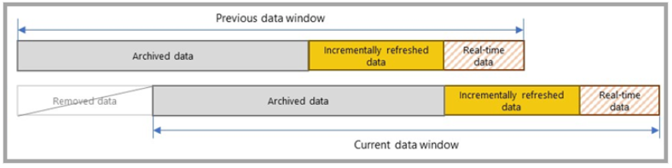
Incremental Refresh
Composite Model
Incremental refresh dynamically partitions and separates data that needs to be refreshed frequently from data that can be refreshed less frequently.
Creates hybrid fact tables made of both imported partitions and a DirectQuery partitions
DirectQuery partitions to access new, real-time or frequently changing data
Imported partitions to access static, historical and frequently used data
© 2021 Microsoft All rights reserved.

Slide 17
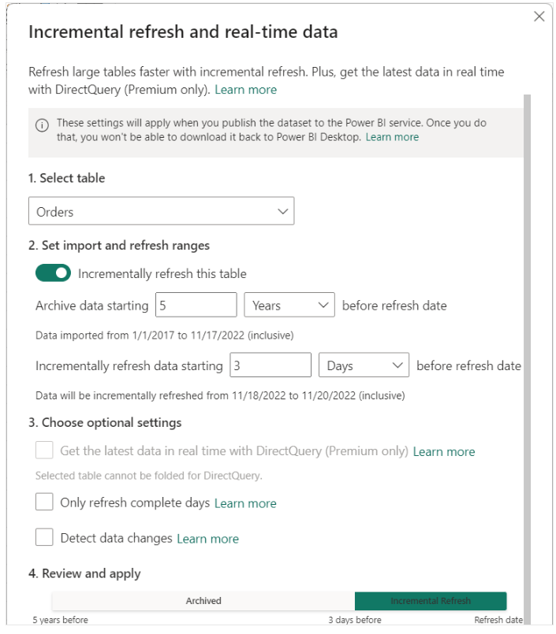
Incremental Refresh Advantages
Composite Model
Fewer Refresh as DirectQuery captures latest data updates thus reducing the need for high refresh cadence.
Faster Refreshes as only the new/changed data is refreshed.
More Reliable Refreshes because shorter/faster queries reduce potential for network problems
Reduce Resource Consumption because less data to refresh reduces load on both PBI and data source systems.
Scalability because large datasets can grow without being fully refreshed with each refresh operation.
Easy Setup
Incremental refresh policies defined in Power BI Desktop
Service automatically applies those policies on initial deployment and with each refresh.
Incremental Refresh Configuration

Slide 18
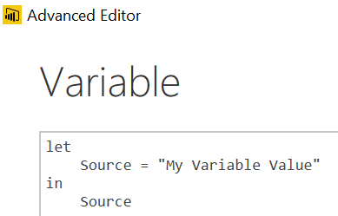
Variables and Parameters
M Variables
Query with a constant value, table or list result
Create with a new blank query
Query name is the Variable name to use in other queries
Type the variable value in the formula bar
Advanced Editor would look like this:
M Parameters
Parameters take Variables to the next level.
Parameters can be any valid data type
The most common are hard keyed single, switchable values
The values list for a parameter can also come from a query that is formatted as a LIST
Parameter used as Source Input
Parameter Usage
Be Creative!
SQL Server
For Database Name
For Server (Switch Dev, Test, Prod)
“Where Clauses” in SQL Queries
To pull all Orgs, or just a single one
SharePoint Team site names
If they are based on a template, you can easily share queries
File Paths and File Names
Have a single place where you need to make a change
Parameters | Microsoft Docs

Slide 19
Data Types
Numeric Data Types
Whole Number
Decimal Number
Fixed Decimal Number (Floating point stored as integer)
Boolean
Date/Time Data Types
Date – Internally stored as an integer
Time – Internally stored as a fraction between 0 and 1
Date Time
Other Data Types
Text
Any – Avoid
Set your Data Types in the Query Editor
Set your Data Formats ($ %, etc) in the Data Model
Pro Tip: Data type is different from data format

Slide 20
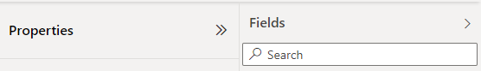
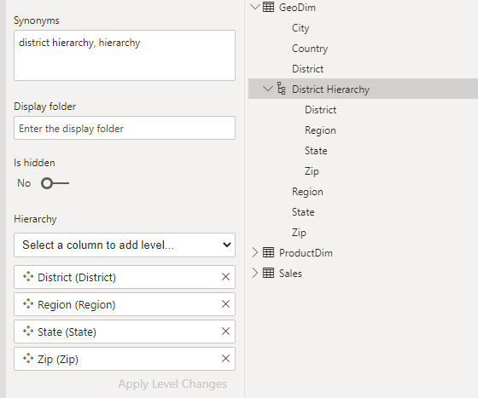
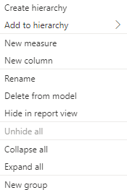
Hierarchies
Power BI generates date hierarchies when dates are added to visuals
End user can then drill from Year, Quarter, Month to Day.
Custom hierarchies can be created by right clicking on each hierarchy item in the right most pane of each views.
Creating and especially modifying a hierarchy in the Model View is highly recommended
Hierarchy can be surfaced and created both in the Data pane and within each tables of the model
The Hierarchy menu in the properties pane of the Model view greatly facilitates the tasks

Slide 21
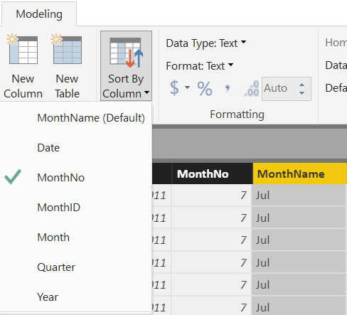
Sort By Column
Sort By Column
Enable sorting one text field by another (numeric) field
Both columns must have the same number of distinct values

Slide 22
Aggregations
Aggregations
Using aggregations in Power BI enables interactive analysis over big data.
Advantages of aggregations are:
Query performance over big data
Data refresh optimization
Achieve balanced architectures
User-defined aggregations - Power BI

Slide 23
Advanced
Power BI Training
Module 1 Lab
Lab 1a – Import Data
Lab 1b – Create Parameter

Slide 24
Module 2
Advanced
Power BI Training
Data Modeling

Slide 25
Module 2 Objectives
Advanced
Data Modeling
Power BI
Training
Understand basic data modeling
Understand basic data model types
Explore dimension tables and fact tables
Explore data connections

Slide 26
What is a Data model?
Advanced
Power BI
Training
Power BI Data Model is a collection of tables with relationships which enables users to easily understand and explore their data to extract valuable business insights.
Why is it important to have a Good Data model?
Improves understandability of the data
Increases performance of dependent processes and systems
Increases resilience to change - Flexible, Scalable, Adaptable
What is easier with a good data model?
Managing Storage constraints
Performance Tuning
Managing Row Level Security
Authoring DAX
Everything!

Slide 27
Guiding Questions
Advanced
Power BI
Training
What are you measuring?
What types of business problems are you trying to solve?
How much data are you working with?
What are your data sources?

Slide 28
Data Model Levels
Advanced
Power BI
Training
Conceptual
the “what” model
Logical
the “how” of the details
Physical
the “how” of the implementation
Sales
Sales
Sales Fact
Transaction Number
Product
Sale Date
Sales Amount
Fact Sales ID [int] IDENTITY(1,1) NOT NULL
Transaction Number [varchar](64) NULL
Product ID [int] NOT NULL
Sale Date ID [int] NOT NULL
Sales Amount [decimal](19,2) NULL
Products
Product
Products Dim
UPC
Name
Category
Price
Product ID [int] IDENTITY(1,1) NOT NULL
UPC Code [varchar](12) NOT NULL
Product Name [varchar](128) NOT NULL
Product Description [varchar](512) NUL

Slide 29






Conceptual Data Model
Advanced
Power BI
Training
Date
Attributes:
Year, Quarter, Month, Day
Holiday, Weekend
Model Elements
Entities
Attributes
Relationships
A conceptual model can help:
Organize scope
Define business concepts / rules
Customer
Organizations that purchase our products
Relationships
Products (sale)
Employee (salesperson)
Product
Objects we sell
Relationships
Customer(sale)
Warehouse (location)
Warehouse
Buildings where we store and from which we ship our products
Relationships
Product(location)
Store
Sales
Employee
Salesperson
Relationships
Customer (sale)
The conceptual data model often requires the involvement of business stakeholders and domain experts.

Slide 30
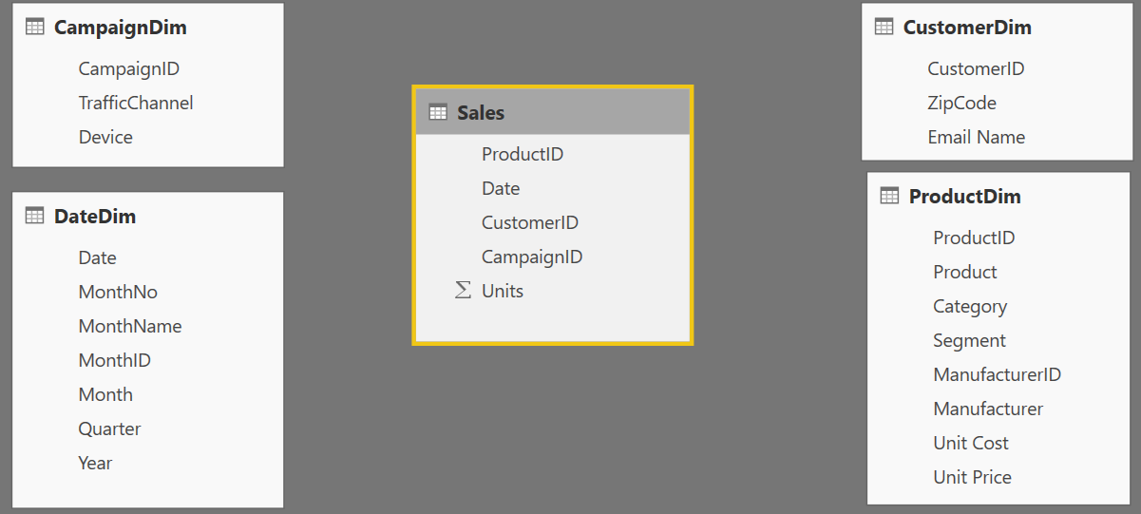
Components of a data model – Fact Tables
Fact
Table
Fact Table
Contains measurements, metrics, facts (or items to be aggregated) of a business process
Examples:
Transactions
Sales Revenue
Units
Cost
Measures are usually sliceable.
Examples:
By Month, By Customer
A fact table has two types of columns: Facts and Foreign Key Columns

Slide 31
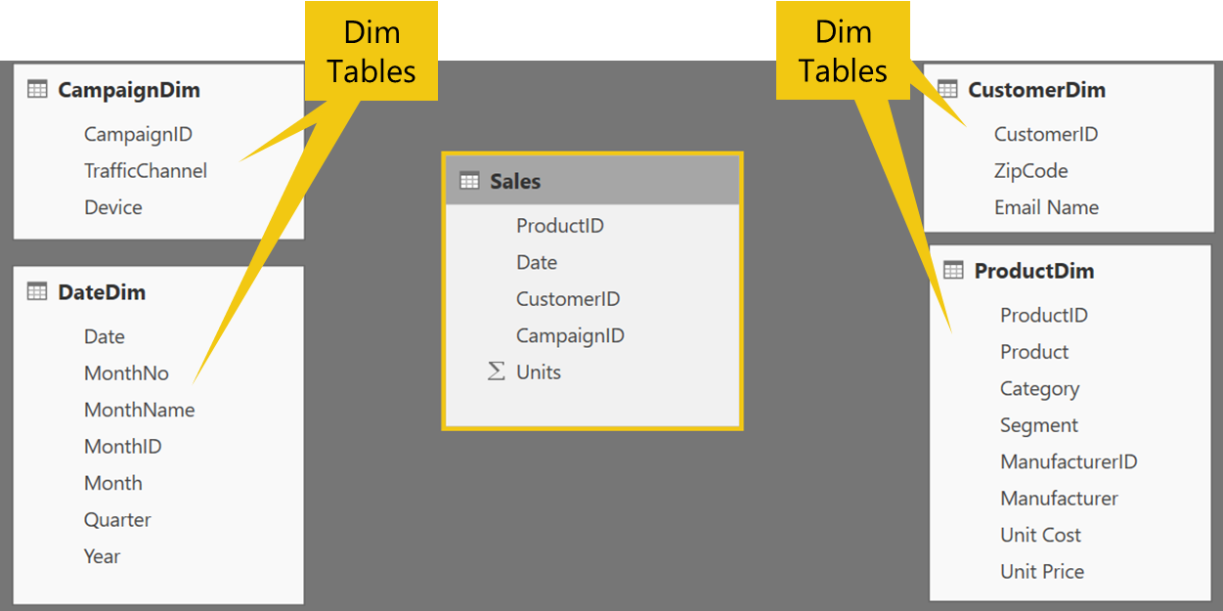
Components of a data model – Dimension Tables
Dim Table
Contains descriptive attributes that:
Define how a fact should roll up
Constitute report filters
Define business hierarchies
Examples: By month, By Customer, By Geo
“Dimensions provide the “who, what, where, when, why, and how” context surrounding a business process event”
- Ralph Kimball

Slide 32
Table Types Comparison
 | Dimension table | Fact table
Purpose | Stores business entities Descriptive | Stores events or observations Factual
Structure | Includes a key column and descriptive columns for filtering and grouping | Includes dimension key columns and numeric measure columns that can be summarized
Data volume | Typically, contains fewer rows (relative to fact tables) | Can contain numerous rows
Shape | Short & Wide (relative to fact tables) | Long & Narrow
Keys | Unique Primary Keys | Multiple Foreign Keys
Query purpose | To filter and group | To summarize

Slide 33
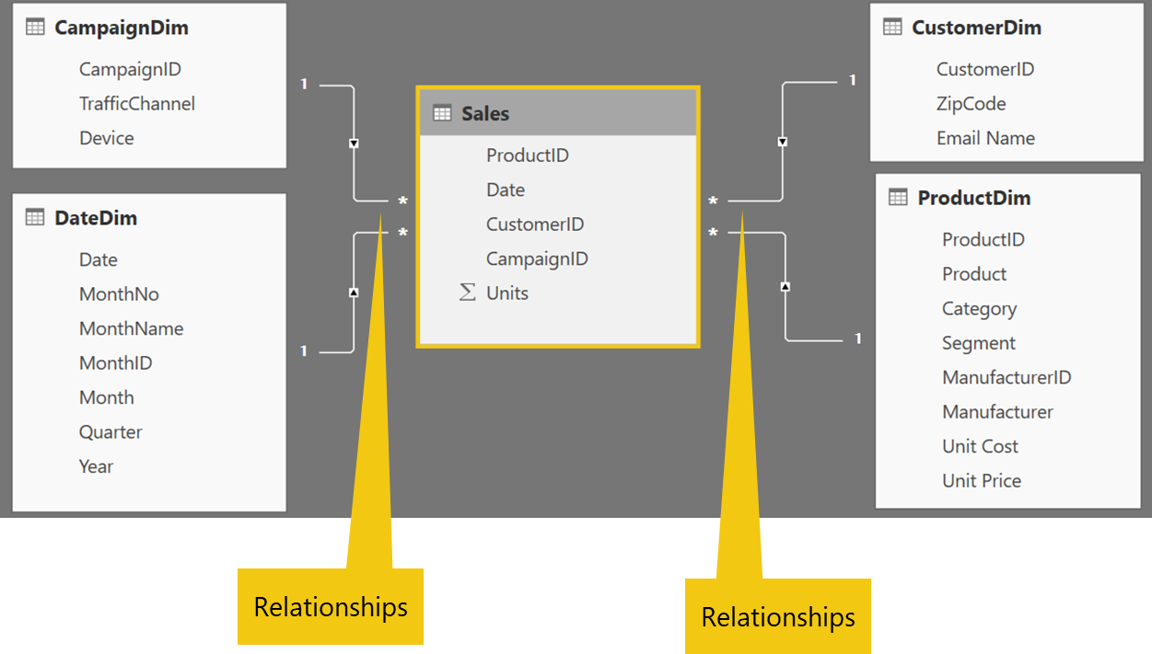
Components of a data model – Relationships
Relationships
Connection between 2 tables (usually Fact & Dim tables) using columns from each
3 kinds of Relationships
1 to Many
1 to 1
Many to Many
(with a bridge table)

Slide 34
Type of Data Models
Those are the most common model types used by Power BI other models can be supported.
Type of Data Models
Star Schema
Snowflake Schema
Flat or Denormalized

Slide 35
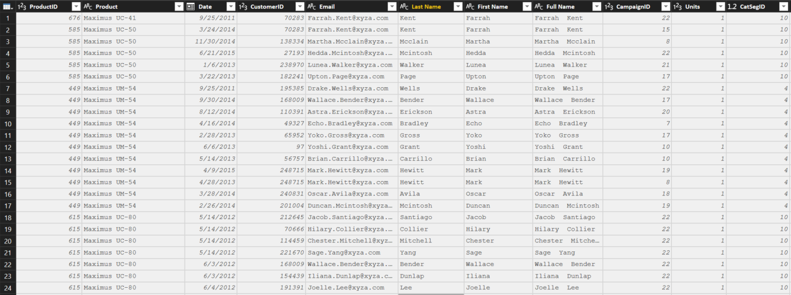
Flat or Denormalized schema
All attributes for model exist in a single table
Model has extra copies of data > slow performance
Size of a flat table can blow up really quickly as data model becomes complex

Slide 36
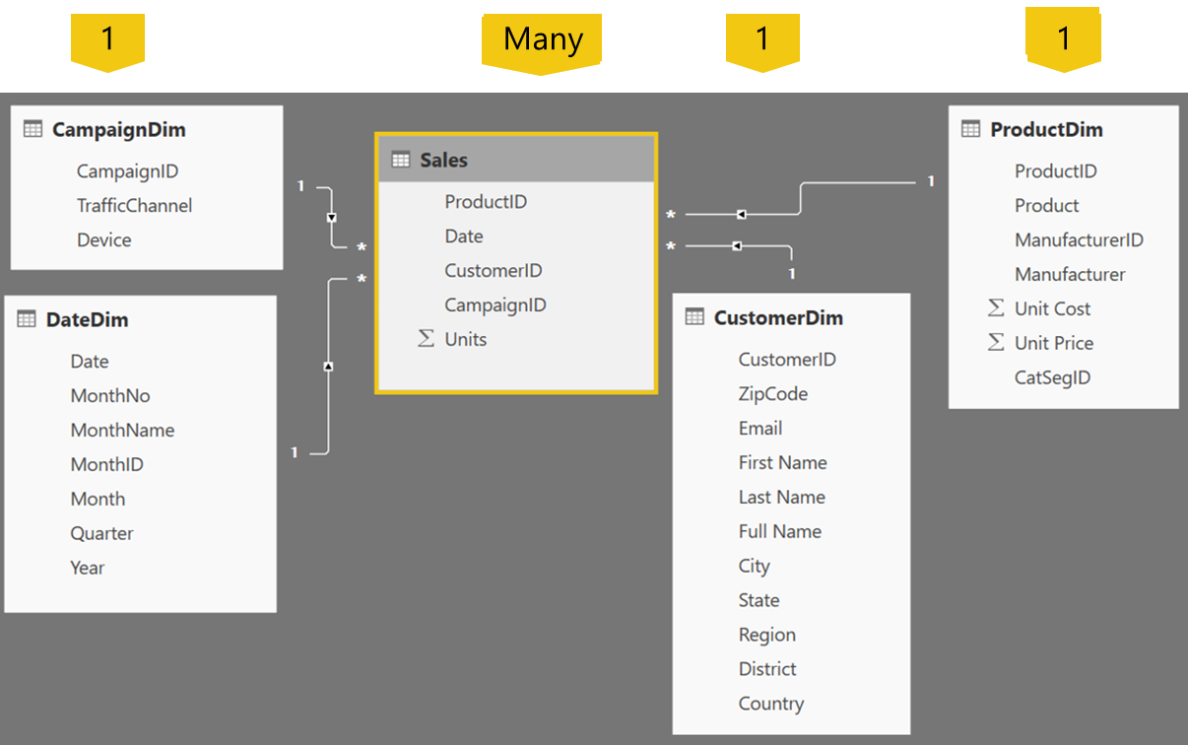
Star Schema
Fact table in the middle
Surrounded by Dims
Looks like a ‘Star’
Fact table is the “Many” side of the (one to many) relationship
The table names should be consistent and meaningful

Slide 37
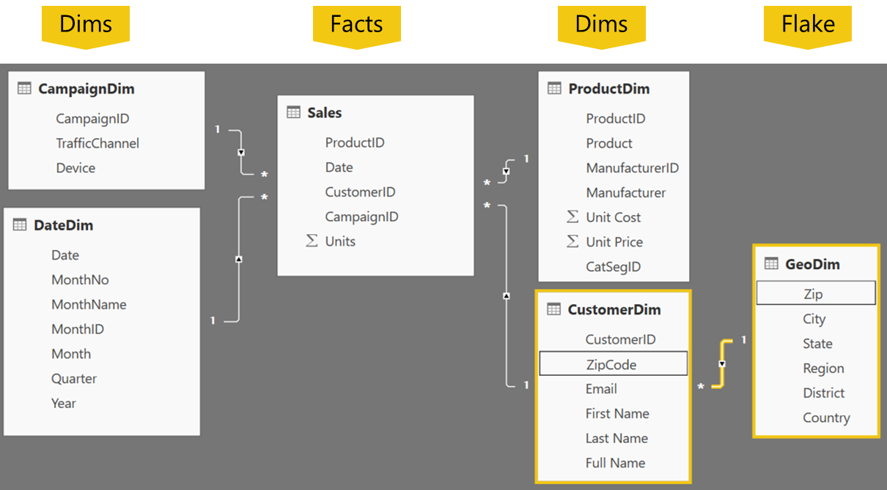
Snowflake Schema
Center is a Star schema
Fact table in middle
Surrounded by Dims
Dims “snowflake” off of other Dims
If you have many, it looks like a ‘Snowflake’
Dim or Fact tables can be the “Many” side of the relationship
Snowflake

Slide 38
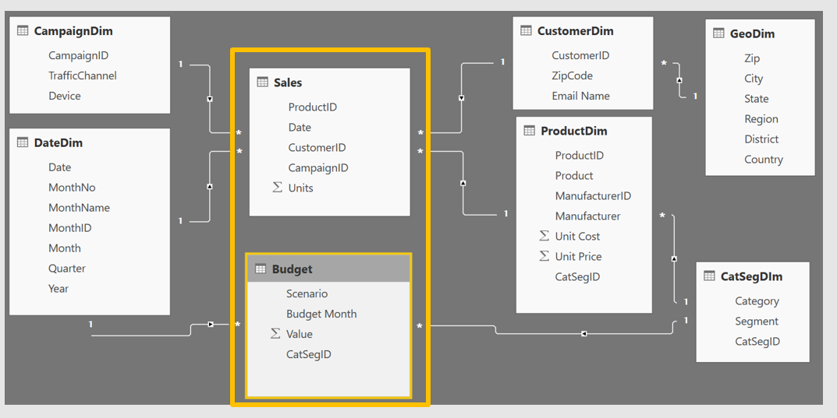
Granularity & Multiple Fact
Grain (granularity) measures the level of detail in a table
Example:
One row per order or per Item
Daily or Monthly date grain
If your facts have very different granularities, split them into Multiple Fact tables & connect them to shared dimensions at the lowest common granularity.
Sales (Daily by Product)
Budget (Monthly by Product Category & Product Segment)

Slide 39
Data Modeling
Advanced
Power BI Training
Module 2 Lab

Slide 40
Module 2 Labs
Data Modeling
Advanced
Power BI
Training
Lab 2a – Create CatSegDim Dimension
Lab 2b – Update Dimension
Lab 2c – Create Customer Dimension
Lab 2d – Create Budget Fact Table

Slide 41
Data Modeling
Advanced
Power BI Training
Knowledge Check

Slide 42
Module 2 Knowledge Check Questions
What is a data model in the context of Power BI?
A Cube
Star Schema
Collection of Tables and Relationships
What is the core of the dimensional model?
Star
Fact Table
Dimension Table
Why is it important to have a good data model?
Improves understandability of the data
Decreases resilience to change
Processes may take longer

Slide 43
Module 2 Knowledge Check Questions
What table should measures exist in?
Dimension table
Fact table
Date table
What are some advantages of a star schema over a flat or denormalized model?
Dimension tables save space by reducing the amount of data that needs to be repeated over and over in every row
Relationships between tables can be leveraged for more complex measures
it is less complex to understand
There is only one table
How might you improve the performance of a Power BI model?
a star schema instead of a flat or denormalized model
Set appropriate data types
Remove unnecessary columns
Use data aggregations
All of the above

Slide 44
Module 3
Advanced
Power BI Training
M Language
a.k.a. Power Query

Slide 45
Module 3 Objectives
Advanced
M Language
Power BI
Training
Get introduced to M
Understand key components and syntax

Slide 46
What is M?
Advanced
Power BI
Training
Formerly known as Power Query
M has amazing capabilities to transform data to optimize it for the data model
The Power Query Formula Language is a powerful query language optimized for building queries that mashup data. It's a functional, case sensitive language.
For computer language theorists:
Power Query is a mostly pure, higher-order, dynamically typed, partially lazy, functional language. You can create a variety of data mashup queries from simple to advanced scenarios.
Source: MSDN

Slide 47
How do I use M?
Advanced
Power BI
Training
Three ways to write M
Click and Adjust
Custom Code
Use the Ribbon
Simple
Advanced

Slide 48
Key Concepts of M
M Values | M Functions | M Syntax
Used to create new artifacts and literals | Foundation of transformations | How your queries are structured
#date(2016,01,01) #date(YYYY,MM,DD) #datetime(2016,02,26, 09,15,00) #datetime(YYYY,MM,DD,HH,MM,SS) #table({"X","Y"},{{0,1},{1,0}}) [a = 100, b = 200] | Syntax: Object.Action() Objects: Table, List, Record, Text, Number, Date, etc. Actions (Camel Case): ToList, DayOfWeek, ToNumber, FromText, etc. Examples: Table.SelectRows, Date.FromText, Number.FromText | let in each if then else true false error and or not try otherwise as is meta section shared type

Slide 49
Primitive Type Values
Type | Example |  | Type | Example
binary | #binary("AQID") |  | list | {“foo”, “bar”, 10}
date | #date(2021,7,10) |  | record | [a = 10, b = 20]
time | #time(18,30,0) |  | type | Value.Type(10)
datetime | #datetime(2021,7,10,18,30,0)
datetimezone | #datetimezone(2021,7,10,18,30,0,0,6)
duration | #duration(1,0,0,0)
logical | true and false
null | null
number | 0, 1, -1, 1.5
text | “hello, world”

Slide 50
Text Functions
M Function Syntax | Excel Syntax | M Output
Text.Start([MyColumn], 3) | LEFT([MyColumn], 3) | ABC
Text.End([MyColumn], 4) | RIGHT([MyColumn], 4) | 5xyz
Text.Range([MyColumn], 4, 3) | MID([MyColumn], 5, 3) | 234
Text.Range([MyColumn], 4) | MID([MyColumn], 5) | 2345xyz
Text.StartsWith ([MyColumn], "abc") | IF(LEFT([MyColumn], 3)=“abc” , TRUE(), FALSE()) | FALSE (Excel -> TRUE)
Text.StartsWith ([MyColumn], “ABC") | IF(LEFT([MyColumn], 3)=“ABC”, TRUE(), FALSE()) | TRUE
Text.Length([MyColumn]) | LEN([MyColumn]) | 11
Text.Contains ([MyColumn], "123") | IF(ISNUMBER(SEARCH(“123", [MyColumn])),TRUE(), FALSE()) | TRUE
Text.PositionOf ([MyColumn], "5" ) | SEARCH(“5", [MyColumn]) | 7 (Excel -> 8)
© 2021 Microsoft All rights reserved.

Slide 51
Text Functions
M
Excel
Position
0 1 2 3 4 5 6 7 8 9 10
1 2 3 4 5 6 7 8 9 10 11
My Column
A B C 1 2 3 4 5 x y z
A B C 1 2 3 4 5 x y z
Return "ABC"
Text.Start([MyColumn], 3)
LEFT([MyColumn], 3)
Return "234"
Text.Range([MyColumn],
4
, 3)
MID([MyColumn,
5
, 3)
Find position of "5"
PositionOf([MyColumn], "5") =
7
SEARCH("5", [MyColumn]) =
8
© 2021 Microsoft All rights reserved.

Slide 52
if….then….else
Basic Syntax: if <test if true> then <result if true> else <result if false>
if’s can be chained or nested
No parentheses () are required, except
When if test or results have multiple conditions:
(condition 1 and condition 2)
(condition 1 or condition 2)
(condition 1 or (condition 2 and condition 3))
If multiple if’s are used ensure you have the same number of “if”, “then”, “else”
Simple example (1 each of if, then & else)
=if [Column2] = "Key" then [Column2] else “Other”
Chained example (3 each of if, then & else)
=if Text.EndsWith([Column2],"Key") then [Column2] else
if [Column2] = "TotalCost" then "Cost $" else
if [Column2] = "SalesQuantity" then "Sales #" else null
Nested example (3 each of if, then & else)
=if Text.EndsWith([Column2],"Key") then
if [Column2] = "TotalCost" then "Cost $" else
if [Column2] = "SalesQuantity" then "Sales #" else null
else “Item #"
Multiple conditions example (1 each of if, then & else)
=if (Text.Length([Column2]) = 3 or Text.Length([Column2]) = 2 )
then true else false
© 2021 Microsoft All rights reserved.

Slide 53
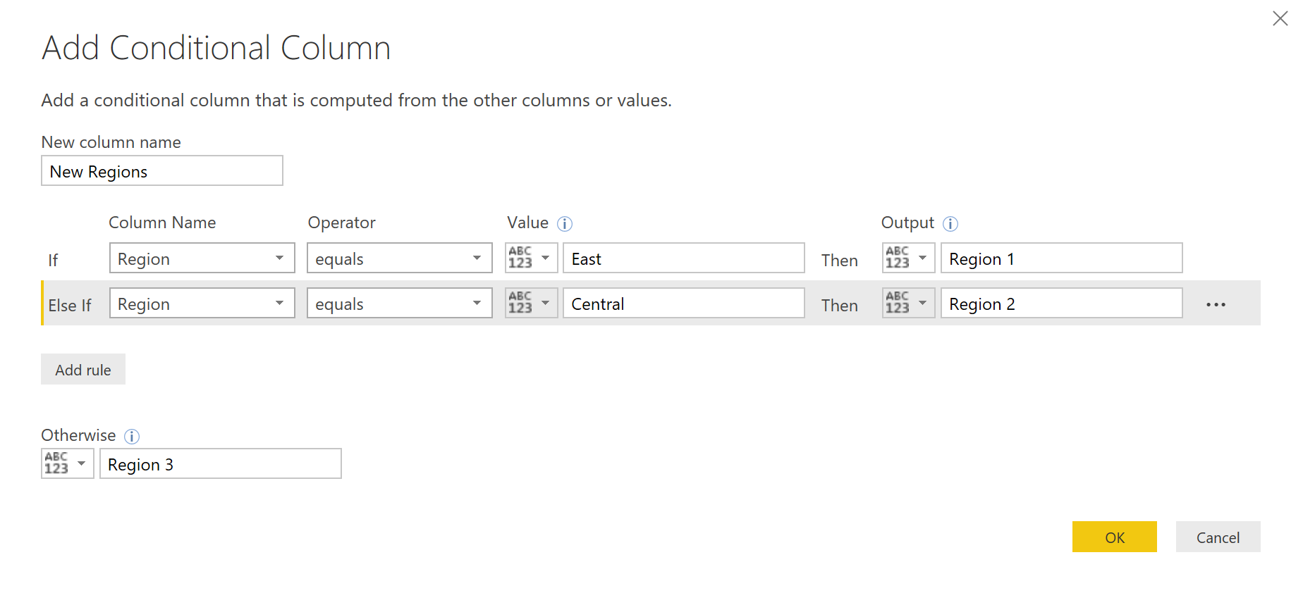
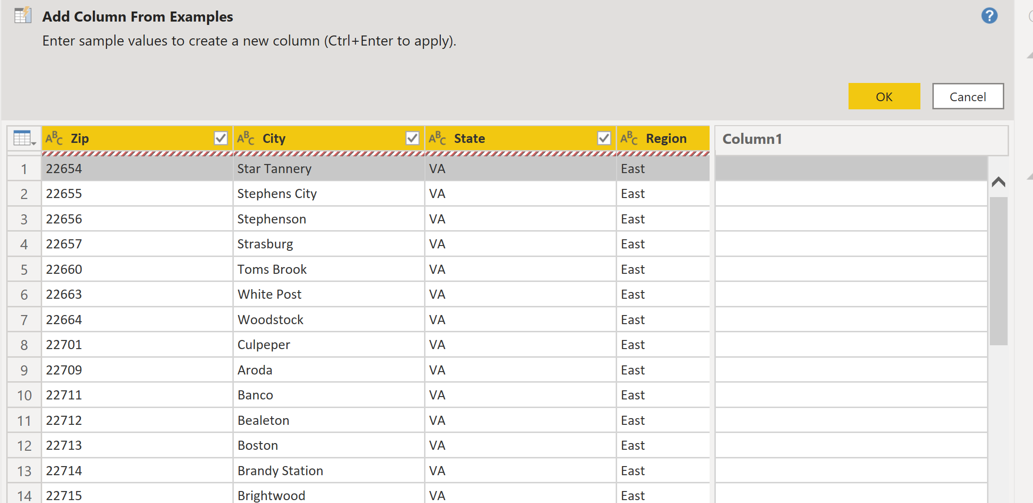
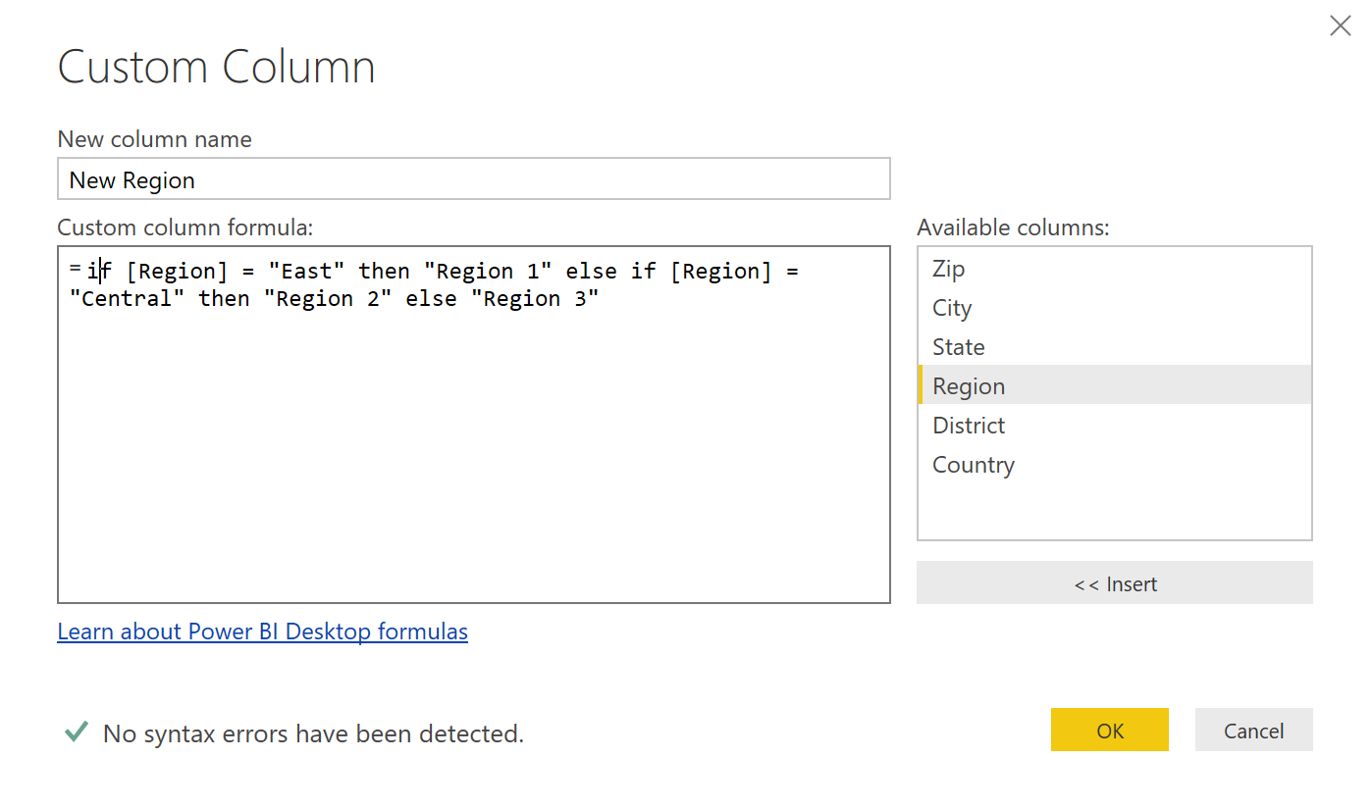
if….then….else
Like many other M functions, If…then…else can be created (or intuited) in several ways:
Conditional Column
Column From Examples
Custom Column

Slide 54
Module 3 Lab
Advanced
Power BI Training
Create relationships
between tables

Slide 55
M Language
Advanced
Power BI Training
Knowledge Check
Module 3

Slide 56
Module 3 Knowledge Check Questions
What is M used for?
Transform data to optimize it in a data model
To build queries that mashup data
To separate facts and dimensions
All of the above
Which way can you NOT use M?
Write custom code
Using the ribbon
Create measures
All of the above
Is DAX case sensitive?
Yes
No

Slide 57
Module 3 Knowledge Check Questions
Is M case sensitive?
Yes
No
Are if then else statements used in M?
Yes
No
Only in DAX
Can M script be replaced by automated functions?
Yes
No
Only when combined with DAX

Slide 58
Module 4
Advanced
Power BI Training
Logic Operators

Slide 59
Module 4 Objectives
Logic Operators
Advanced
Power BI
Training
Understand Key M Transformations
Understand Join operations

Slide 60
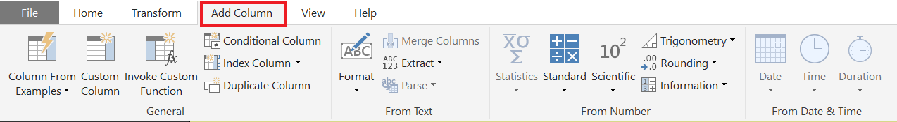
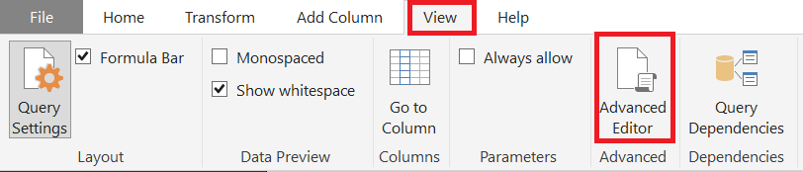
Key Transformations
M is the key to data transformation in Power BI
Many transforms are just a click away on the Ribbons
View full syntax in Advanced Editor
M is Column Based
Many Transformations occur by adding columns
M is CaSe SeNsItIvE!

Slide 61

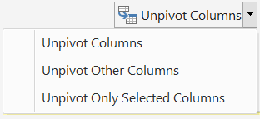
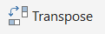
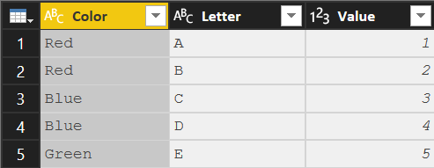
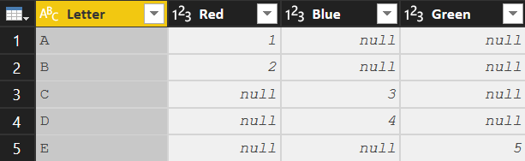
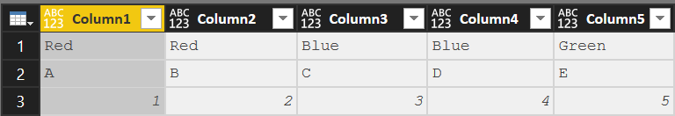
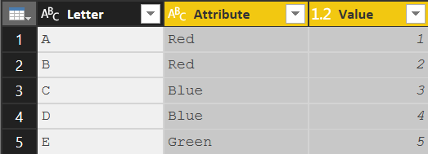
Key Transformations
Transpose
Convert Rows to Columns and
Columns to Rows
Syntax: Table.Transpose(Previous)
Column headers are lost
To transpose column headers, demote them to data prior to transpose
Pivot Column
Convert Selected column of values into Column Headers
Syntax: Table.Pivot(Previous,List.Distinct(Previous[Color]), "Color", "Value", List.Sum)
The values in [Color] column are converted to headers
The values in the [Value] column are filled in where applicable
Unpivot Columns
Convert Selected Column Headers into
column of values
Syntax: Table.UnpivotOtherColumns(Previous, {"Letter"}, "Attribute", "Value")
The unpivoted column headers become the column [Attribute]
The unpivoted values become the column [Value]
Note: Previous => Name of the previous step in the query

Slide 62
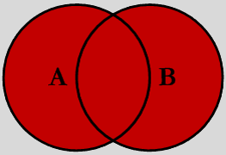
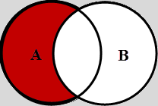
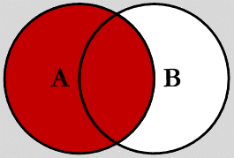

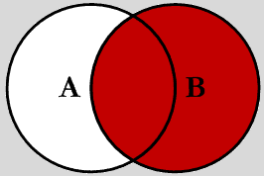
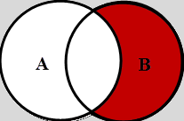
Join Kinds – Merge Types
Full Outer (JoinKind.FullOuter)
Shows all of the rows from both queries. Like SQL “Union All”
Left Outer (JoinKind.LeftOuter) Default for Merge
Shows all rows in 1st query (A) and “paints” attributes from second query (B) based on matches in joined column(s).
Left Anti (JoinKind.LeftAnti) Shows ONLY rows in 1st (A) query where there is NO MATCH to 2nd query (B) based on joined column(s)
Inner (JoinKind.Inner)
Limits the rows to ONLY those which Match on joined column(s)
Right Outer (JoinKind.RightOuter) Shows all rows in 2nd (B) query and “paints” attributes from 1st query (A) based on matches in joined column(s)
Right Anti (JoinKind.RightAnti) Shows ONLY rows in 2nd (B) query where there is NO MATCH to 1st query (A) based on joined column(s)
Note: One or Multiple columns can be used to create the join

Slide 63
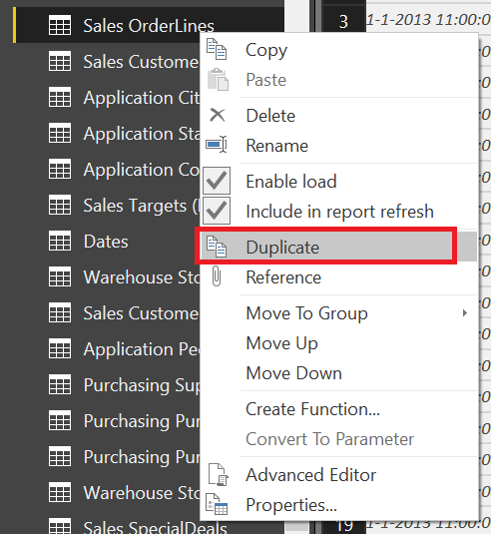
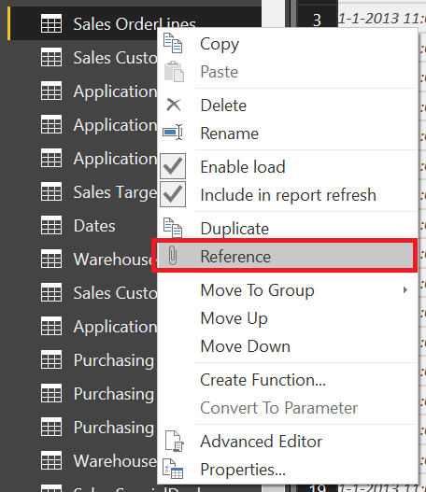
Table Duplicate vs Table Reference
Duplicate
Copies a query at a point in time (Save As)
Duplicate query can be modified independently without altering the original query
Executing the 2nd query (duplicate) does NOT execute the 1st (original) query
Reference
Uses the output of one query as the INPUT in another query. (Link in a chain)
All subsequent changes made to 1st query affect the 2nd during refresh
When the 2nd query executes, it re-executes all the steps in the 1st query

Slide 64
Join Kinds – Other Combining Queries
Merge Combines attributes (columns) of two queries based on a joined columns(s)
Column(s) used for the join must be in both queries (can be one or more)
Both queries rerun with each execution
In Database terms, this is a JOIN
Append “Stack” records of two (or more) queries
Both (all) queries rerun with each execution
Like column headers must be named the same
Non-matching columns will be added to the right as extra colunns
Duplicate
Copies a query at a point in time (Save As)
Duplicate query can be modified independently without altering the original query
Executing the 2nd query (duplicate) does NOT execute the 1st (original) query
Reference Uses the output of one query as the INPUT in another query. (Link in a chain)
All subsequent changes made to 1st query affect the 2nd during refresh
When the 2nd query executes, it re-executes all the steps in the 1st query

Slide 65
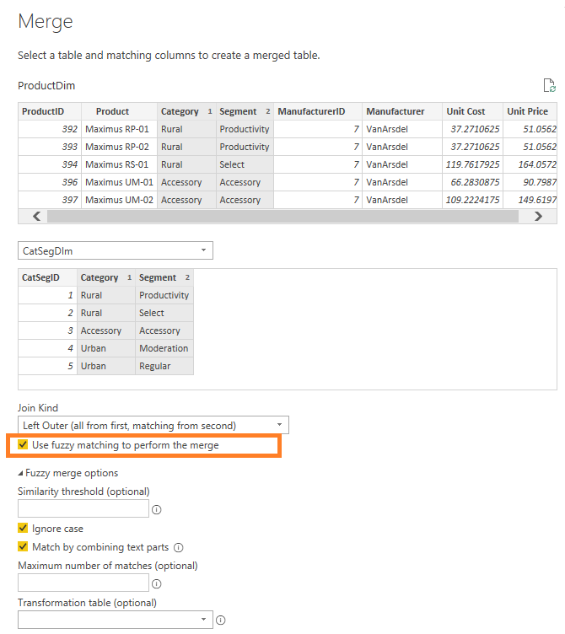
Fuzzy Merge
Apply Fuzzy Matching algorithms when comparing columns and try to find matches across tables being merged.

Slide 66
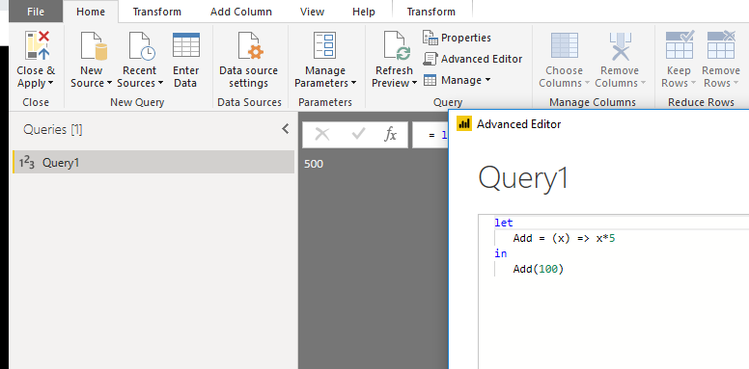
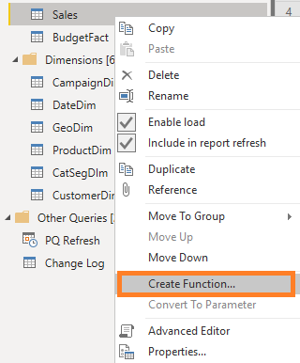
Custom Functions
Custom Functions help you re-use code
Create function using Blank query
Create function using baseline query
© 2021 Microsoft All rights reserved.

Slide 67
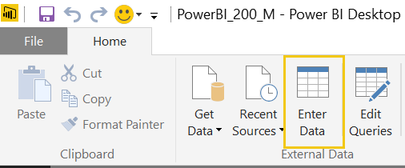
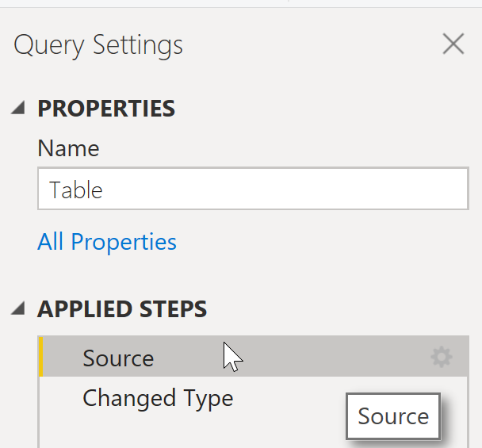
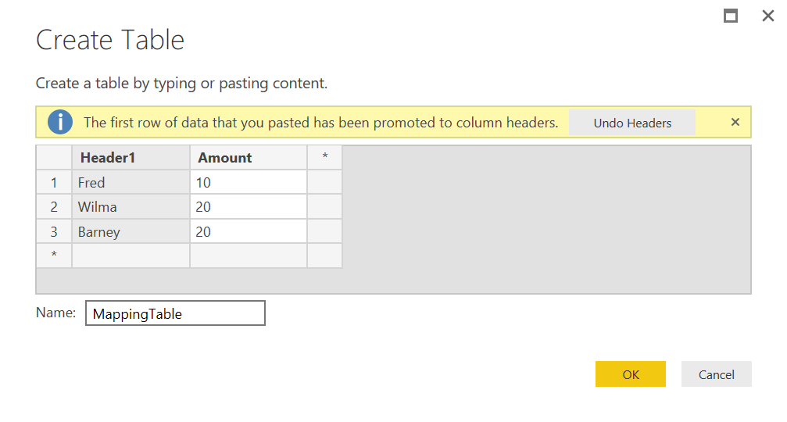
Enter Data
To add additional rows or columns later, click the gear icon.
© 2021 Microsoft All rights reserved.

Slide 68
Module 4 Lab
Advanced
Power BI Training
Lab 4a
Create dynamic
path to Excel

Slide 69
Module 4
Advanced
Power BI Training
Knowledge Check

Slide 70
Module 4 Knowledge Check Questions
What does the Transpose transformation do?
Convert selected rows to column headers
Convert columns to rows, and rows to columns
Convert column headers into values
What does the Append transformation do?
Combines two queries based on joined columns
Stacks records of two or more queries
Copies a query at a point in time
Which is the best way to add a table on the fly?
Use Enter Data from the ribbon
Write a new SQL statement
Import an additional table
© 2021 Microsoft All rights reserved.

Slide 71
Module 5
Advanced
Power BI Training
Calculated Columns
vs
Calculated Measures

Slide 72
Calculated Column vs. Calculated Measures
Calculated Column values are calculated for each row and are stored in the model
They require little virtual memory when user interacts with the report
However, avoid creating them if you want to reduce the model size
Whenever possible, create calculated column in:
The Dim Table; the table with the highest level of granularity
In M language (in the Query Editor) as they consume more RAM when calculated in DAX
Calculated Measures are aggregation and not stored in the model
→ Faster calculation but uses more processing power to execute a time of query
Calculated Columns | Calculated Measures
Computed during data refresh | Computed when measure is used
Belong to Table | Belong to Data Model
Stored in Data Model | Not stored; Formula only
Operate on current row context | Operate on current filter context

Slide 73
Calculated Column VS. Calculated Measures
Use | When you want to
Calculated Measures | Calculate aggregate values
 | Reflect the filters selections in calculation result
 | Reduce model size (to minimize number of calculated columns)
Calculated Columns | Define an expression strictly useful on row level
 | Use the result of a calculation in a slicer
 | Create categories
 | High re-use of metrics

Slide 74
Module 6
Advanced
Power BI Training
Power BI
Performance Factors

Slide 75
Module 6 Objectives
Power BI
Performance Factors
Advanced
Power BI
Training
Understand the factors that influence performance
Understand the multiple engines that power Power BI

Slide 76
Performance Factors
The good performance of a Power BI report essentially hinges on the following factors:
Network Latency
Power BI Licensing tier
Number of (simultaneous) users
Row Level Security
Data Source
Data Volumes
Storage Mode
Model Design
DAX Calculations
Report Design

Slide 77

Under The Hood
The key to delivering scalable, reliable, and high-performing Power BI reports is to create tabular models that
Optimize Storage, Memory and Computing Capacity
Analysis Services, Power BI and Excel PowerPivot/Query are powered by the same technology; a Storage Engine and Formula Engine that together help achieve a balance between a model’s size and its performance.
The formula engine (FE) processes the DAX request, generates the query plan and executes it.
The storage engine (SE) retrieves data from model to answer requests made by the formula engine
Data Analysis Expressions (DAX) is the language that performs advanced calculations and formulate the request sent to the storage engine.

Slide 78
Storage Engine – Encoding & Compression
Data Compression Engine
VertiPaq - also known as xVelocity in Power Pivot – is an in-memory columnar database engine that converts rows imported from the source data into an optimized storage organized by columns, encoding & compressing each column’s data individually.
Compression allows the engine to fit more data into memory and speed up most analytical queries by providing quick access to relevant data without scanning through whole tables.
The VertiPaq compression algorithms reduces the memory footprint of a data model by:
reducing the size of the model
reducing the amount of RAM required to read its content.
VertiPaq can compress data by a factor of 10
The VertiPaq compression only applies to imported data. The engine stores a copy of the initial data in memory and data will only update the next time it is downloaded or refreshed from the data source.
In DirectQuery mode queries are directly forwarded to the original data source for every request.

Slide 79
Storage Engine – Encoding & Compression
Encoding & Compression
VertiPaq automatically applies a combination of the following encoding and compression technics:
Value encoding applies to numeric columns and reduces integer values to their lowest storage size based on their characteristics, distribution and identified discovered mathematical relationships.
Dictionary encoding (a.k.a. Hash encoding) entails:
Building a dictionary of distinct text values of a column
Indexing each value in the list with integers (assign integers to each value)
Replacing the column values with indexes (integer values) in the dictionary
Run-Length Encoding (RLE) identifies and roll up repeating column values resulting in a more compact format that benefits from the sort order of the data.
Bitpacking uses algorithms to represent data with as few as possible number of bits.
Whichever the encoding that Tabular chooses (value or dictionary), the internal data structure will end up consisting of integers.

Slide 80
Comparison to Excel
SaleID | Amount | State | ProductCategory | Store
1 | 4000 | Missouri | High Powered Gaming Personal Computer | StuffMart
2 | 3500 | Arkansas | Mid Powered Business Laptop | StuffMart
3 | 3700 | Kansas | Mid Powered Business Laptop | StuffMart
4 | 4300 | Illinois | Low Powered 2-in-1 Laptop | StuffMart
5 | 4150 | Illinois | Tablet | StuffMart
6 | 4650 | Arkansas | High Powered Gaming Personal Computer | StuffMart
7 | 3350 | Arkansas | Low Powered 2-in-1 Laptop | StuffMart
8 | 2800 | Kansas | Tablet | StuffMart
9 | 4900 | Missouri | High Powered Gaming Personal Computer | StuffMart
10 | 4200 | Illinois | Mid Powered Business Laptop | StuffMart

Slide 81
Conversion to Columns
SaleID
1
2
3
4
5
6
7
8
9
10
Amount
4000
3500
3700
4300
4150
4650
3350
2800
4900
4200
State
Missouri
Arkansas
Kansas
Illinois
Illinois
Arkansas
Arkansas
Kansas
Missouri
Illinois
ProductCategory
High Powered Gaming Personal Computer
Mid Powered Business Laptop
Mid Powered Business Laptop
Low Powered 2-in-1 Laptop
Tablet
High Powered Gaming Personal Computer
Low Powered 2-in-1 Laptop
Tablet
High Powered Gaming Personal Computer
Mid Powered Business Laptop
Store
StuffMart
StuffMart
StuffMart
StuffMart
StuffMart
StuffMart
StuffMart
StuffMart
StuffMart
StuffMart

Slide 82
Encoding Example 1: Value
Amount
4000
3500
3700
4300
4150
4650
3350
2800
4900
4200
Amount
120
70
90
150
135
185
55
0
210
140
MAX VALUE = 4,900
MIN VALUE = 2,800
DELTA = 2,100
AMOUNT FORMULA = X / 10 – (2800/10)

Slide 83
Encoding Example 2: Hash + Dictionary
State
Missouri
Arkansas
Kansas
Illinois
Illinois
Arkansas
Arkansas
Kansas
Missouri
Illinois
State
0
1
2
3
3
1
1
2
0
3
State | Index
Missouri | 0
Arkansas | 1
Kansas | 2
Illinois | 3
Create a Dictionary
Reference Dictionary

Slide 84
Encoding Example 2: + Run Length
State | Index
Missouri | 0
Arkansas | 1
Kansas | 2
Illinois | 3
State
0
1
2
3
3
1
1
2
0
3
Index | Start | Count
0 | 1 | 1
1 | 2 | 1
2 | 3 | 1
3 | 4 | 2
1 | 6 | 2
2 | 1 | 1
0 | 1 | 1
3 | 1 | 1
Determine ordered Run Length

Slide 85
Encoding Example 3: H + D + RL Comparison
Efficient
Inefficient
Store
StuffMart
StuffMart
StuffMart
StuffMart
StuffMart
StuffMart
StuffMart
StuffMart
StuffMart
StuffMart
Store | Index
StuffMart | 0
SaleID
1
2
3
4
5
6
7
8
9
10
SaleID | Index
1 | 0
2 | 1
3 | 2
4 | 3
5 | 4
6 | 5
7 | 6
8 | 7
9 | 8
10 | 9
Index | Start | Count
0 | 1 | 1
1 | 2 | 1
2 | 3 | 1
3 | 4 | 1
4 | 5 | 1
5 | 6 | 1
6 | 7 | 1
7 | 8 | 1
8 | 9 | 1
9 | 10 | 1
Index | Start | Count
0 | 1 | 10

Slide 86
Encoding Example 4: Row Order Optimization
ProductCategory
High Powered Gaming Personal Computer
Mid Powered Business Laptop
Mid Powered Business Laptop
Low Powered 2-in-1 Laptop
Tablet
High Powered Gaming Personal Computer
Low Powered 2-in-1 Laptop
Tablet
High Powered Gaming Personal Computer
Mid Powered Business Laptop
Index | Start | Count
0 | 1 | 1
1 | 2 | 2
2 | 4 | 1
3 | 5 | 1
0 | 6 | 1
2 | 7 | 1
3 | 8 | 1
0 | 9 | 1
1 | 10 | 1
ProductCategory
High Powered Gaming Personal Computer
High Powered Gaming Personal Computer
High Powered Gaming Personal Computer
Mid Powered Business Laptop
Mid Powered Business Laptop
Mid Powered Business Laptop
Low Powered 2-in-1 Laptop
Low Powered 2-in-1 Laptop
Tablet
Tablet
Index | Start | Count
0 | 1 | 3
1 | 4 | 3
2 | 7 | 2
3 | 9 | 2

Slide 87
Encoding: Final Output
AMOUNT
STATE
PRODUCT CATEGORY
Amount
120
70
90
150
135
185
55
0
210
140
State | Index
Missouri | 0
Arkansas | 1
Kansas | 2
Illinois | 3
ProductCategory | Index
High Powered Gaming Personal Computer | 0
Mid Powered Business Laptop | 1
Low Powered 2-in-1 Laptop | 2
Tablet | 3
Index | Start | Count
0 | 1 | 1
1 | 2 | 1
2 | 3 | 1
3 | 4 | 2
1 | 6 | 2
2 | 1 | 1
0 | 1 | 1
3 | 1 | 1
Index | Start | Count
0 | 1 | 3
1 | 4 | 3
2 | 7 | 2
3 | 9 | 2
FORMULA =
X / 10 – (2800/10)

Slide 88
Formula Engine
The formula engine is the top-level engine that manages the whole architecture of a query.
Understands queries create in DAX as well as in MDX, the query language used for Excel pivot table and multidimensional models.
Generates a logical query plan that the storage engine understands.
Creates physical query plan to be executed.
Physical operations can consist of joins between multiple tables, filtering, or aggregations.
Note: Formula Engine works in a single-threaded way, which means that requests are sent to the Storage Engine sequentially.
DAX Studio is the best tool to obtain details of the query plans and, for experienced developers, to fine tune slow DAX calculations.
DAX Logical & Physical Query Plans

Slide 89
DAX Calculation Process
Stages
Query Plan | FE creates list of logical steps to the SE that specifies what data is needed and how to obtain it.
Data Cache | SE executes the query plan and sends back a table of data to the FE.
Evaluation | FE evaluates the DAX query against the data cache and returns an output.

Slide 90




Formula vs Storage Engine
 | Formula Engine (FE) | Storage Engine (SE)
Name | DirectQuery / DAX | VertiPaq (also called xVelocity)
Function | Query and calculation engine | Data compression and retrieval
Data Used | Uncompressed data cache from Data Cache | Scans and retrieves compressed data in-memory
Expression Type | Complex expression | Simple expression
Optimized for | Complexity | Speed
Speed | Slow – single core | Fast - multi-threaded
Cached Results | No | Yes
Formula Engine
Storage Engine

Slide 91
Optimizing Compression
Factors Affecting VertiPaq Model Compression (in order of importance)
Cardinality of the column, which defines the number of bits used to store a value.
The higher the cardinality of a column, the harder for VertiPaq to optimally compress the data.
The number of repetitions, that is, the distribution of data in a column.
A column with many repeated values will be compressed more than a column with very frequently changing ones.
The number of rows in the table
Estimate current size and projected growth of your model
The datatype of the column (which only affect dictionary size)
Specifying data types improves model size (as well as performance and usability)
Optimization steps taken to address one factor will often address the others.
For example, a column optimized for cardinality will invariably lead to more value repetition and therefore better compression.

Slide 92

Query Folding
Query folding (QF) is the mechanism by which Power BI generates a single query statement to
Offload or push query evaluation and data transformations to the data source and
Provide a much faster query execution than extracting all the required data from your data source and running all transformations required in the Power Query engine.

Slide 93

Query Folding
Transformations that can achieve folding
Transformations that prevent folding
Determine when a query can be folded
Query folding indicators
Query folding examples
Query Plan (Preview feature)
Exploring Query Folding

Slide 94
Module 7
Advanced
Power BI Training
Power BI Modeling
Best Practices

Slide 95
Optimizing Compression
Apply the following recommendations to take full advantage of the VertiPaq engine compression and reduce the physical size of your model
Push transformations to data sources through Query Folding or using views
Remove unused tables and columns
Only keep columns that will be used in the data model / reports
Delete/Hide unused columns, remove or disable load of unused or intermediary tables
Filter early & Filter often
Split high cardinality column such as DateTime and decimal numbers into two distinct columns
Disable unneeded hierarchies which would otherwise be optimized to support MDX queries.
Disable Auto Date/Time in Options
Otherwise, Power BI creates a hidden “LocalDateTable” for every single date value
Consider rolling up data to lower levels of granularity
This is typically achieved through time, product and other business hierarchies
Historical data is often a good candidate for aggregation at a lower level of granularity

Slide 96
Optimizing Compression
Limit the use of calculated columns which, as opposed to measures, are stored in the model
Introduce calculated columns before compression so that they can be included in the sort order evaluation
Shorten values wherever possible:
Transform DateTime to Date
Replace blank values with NULL
Remove unnecessary blank spaces
Specify data types to improve model size, performance and usability
Use integers instead of strings, wherever possible
Use fixed decimal numbers instead of decimal numbers
Where applicable, aggregate table rows
Optimize data processing by using data segment sizes that achieve optimal parallelism and compression.

Slide 97
Optimizing Data Segment Size
Segment size is an important factor at both compression and at query time:
The tabular engine reads a segment and starts compressing it while reading the next one.
The tabular engine also uses the segments at query time to read in parallel across cores.
To optimize data processing,
Tabular (Analysis Services, PBI Premium), by default, processes the data in segments of 8 million rows.
However,
Power BI Desktop and PowerPivot are optimized for smaller datasets and their segment’s default size of 1 million rows cannot be changed.
Models created through Power BI dataset can be optimized for larger dataset by using external tools such as Tabular Editor to override the logic that was originally selected (based on a smaller sample/segment).
Segment Size | Advantage | Impact
Larger segments | better compression | more compression time
Smaller segments | more parallelism | more query time

Slide 98
Optimizing Model Performance
Push calculations to the Source
Use PQ calculated columns rather than DAX calculated columns
Whenever possible, create a calculated column in the Dim Table rather than in the Fact Table
Use a star schema
Avoid Bi-Directional AND Many-to-Many relationships which incur a significant performance penalty
Applying filters/slicers traverses many relationships and can be slower
Some filter chains unlikely to add business value
Remove unnecessary relationships sometimes created by Power BI
Use Integer and presorted index columns that are commonly filtered or sliced

Slide 99
Optimizing Model Performance
Avoid distinct counts on fields with high cardinality
Minimize fields with unnecessary precision and high cardinality which slow calculations and increase time to load into memory
Set Default Summarization to none on the Modeling Ribbon
Power BI otherwise tries to sum or count the number when dropped into visuals.
Detailed tables/matrixes can be slower
Don’t change blanks to zeros or other values
Power BI automatically filters out all the rows with blank values from query results
If the blanks are replaced, the query space is greatly increased
Use Variables in DAX instead of repeating measures
Otherwise, the repeated measure will be re-calculated every time it is mentioned

Slide 100
Optimizing Model Performance
Use DIVIDE() Instead of / with an IF 0 condition
Calculate Ratios Efficiently
Use (a-b)/b with variables instead of a/b – 1 or a/b*100 – 100
Create efficient measures that filter out zero
Be wary of DAX functions which need to test every row in a table –
These functions can exponentially increase run-time and memory requirements given linear increases in table size. i.e SUMX, RANKX
Avoid string manipulation in measures
Slows down measures as work is done in calculation engine

Slide 101
Optimizing Model Performance
Use SELECTEDVALUE() instead of HASONEVALUE() and VALUES()
SELECTEDVALUE()more efficient and safer because it returns blank (instead of an error) in case multiple values are encountered
Use DISTINCT() and VALUES() functions consistently
DISTINCT(): Does not return blank added due to integrity violation.
Use VALUES() in the whole report if possible and blank value is not an issue

Slide 102
Use DISTINCT() and VALUES() functions consistently
Power BI adds a blank value to the column in case it finds referential integrity violation
For direct query, Power BI by default adds blank value to the columns as it does not have a way to check for violations
Difference :
DISTINCT(): Does not return blank which is added due to integrity violation. It includes blank only if it is part of original data
VALUES(): It includes blank which is added by Power BI due to referential integrity violation
The usage of either of the function should be same throughout the whole report
Power BI recommends to use VALUES() in the whole report if possible and blank value is not an issue
© 2021 Microsoft All rights reserved.

Slide 103
Avoid using IFERROR() and ISERROR()
IFERROR() and ISERROR() are sometimes used in measures
These functions force Power BI engine to perform step by step execution of each row to check for errors as there is currently no way that directly states which row returned the error
FIND() and SEARCH() DAX functions provide an extra parameter which can be passed and is returned in case of the search string not present – avoids use of IFERROR/ISERROR
Both of this functions are currently also used to check for divide by zero error or along with values to check if more than one values are returned.
Can be avoided by using the correct DAX functions like DIVIDE() and SELECTEDVALUE() which performs the error check internally and returns the expected results
© 2021 Microsoft All rights reserved.

Slide 104
Use ISBLANK() instead of =BLANK() check
Use inbuilt function ISBLANK() to check for any blank values instead of using comparison operator “= Blank()”
ISBLANK() is faster
© 2021 Microsoft All rights reserved.

Slide 105
Use FILTER(ALL(ColumnName))
To calculate measures ignoring all the filters applied on a column, use All(ColumnName) function along with the FILTER instead of Table or VALUES(). Eg: CALCULATE([Total Sales], FILTER(ALL(Products[Color]), Color = 'Red’))
Directly applying filters using expressions and not using FILTER function behaves in the same way as mentioned above and it internally translates to use ALL function in the filter
Eg: CALCULATE([Total Sales], Products[Color]= 'Red’)) ->
CALCULATE([Total Sales], FILTER(ALL(Products[Color]), Products[Color]= 'Red’)
It is always better to apply filters at desired column than the whole table
Always use ALL along with FILTER function if there is no specific need to keep current context
https://pbidax.wordpress.com/2016/05/22/simple-filter-in-dax-measures/
https://www.sqlbi.com/articles/filter-arguments-in-calculate/
© 2021 Microsoft All rights reserved.

Slide 106
Do not use scalar variables in SUMMARIZE()
SUMMARIZE() traditionally used to perform grouping of columns and get the resulting aggregations along with it
It is recommended to use SUMMARIZECOLUMNS() function which is a newer more optimized version
SUMMARIZE function should only be used to get just the grouped elements of a table without any measures/aggregations associated with it.
E.g. SUMMARIZE(Table, Column1, Column2)
© 2021 Microsoft All rights reserved.

Slide 107
Avoid using ADDCOLUMNS() in measure expressions
Measures are calculated in iterative manner by default
If measure definitions use iterative functions like AddColumns, it create nested iteration which downgrades the performance
© 2021 Microsoft All rights reserved.

Slide 108
Consider Subsets for very large models
Scenario
Large model – hundreds of tables and tens of GB
Large high grain fact tables – millions to billions
Why is it undesired?
Aggregating/measures across large facts can affect performance
Large models become harder to maintain and use ad-hoc
Proposed Solution
Consider aggregations and composite models features
Build manual summary tables with smart measures
Create smaller models for the most common business cases
© 2021 Microsoft All rights reserved.

Slide 109

Data Profiling
Data Profiling allows you easily and quickly understand data distribution
Column statistics
# of errors, empty, valid, duplicated and unique values. Value distribution measures such as Min/Max/Average/Median, etc.
Column distribution
Larger size version of the inline value distribution histograms, also including the ability to keep or remove values, which will generate the corresponding Filter Rows step in your query (“Equals” / “Does Not Equal” filters).
© 2021 Microsoft All rights reserved.

Slide 110
Module 7 Lab
Advanced
Power BI Training
Lab 7b:
Performance Analyzer

Slide 111
Module 8
Advanced
Power BI Training
Tabular Editor

Slide 112


Tabular Editor
Recommended Use: Batch creation, duplication or modification of measures, columns, calculation groups.
Enforcement of best practices. Model documentation.
Excellent Editor Alternative to SQL Server Data Tools (SSDT) and PBI Interface
Author or modify tabular models for Analysis Services and Power BI without workspace server
Edit model metadata and BIM file offline without accessing any data source
No wait or down time even on huge models
Quickly Access & Edit Objects Properties
Edit the properties of one or multiple objects in the tree
Quickly access and instantaneously create or modify tabular model entities:
Measures, Calculated columns, Calculation groups, Display folders, etc..
Best Practices Enforcer
Check whether model objects satisfy established Best Practice rules & suggest corrections
Scripting / Calculation Groups
Automate repetitive tasks using scripts & Calculated Tables
DAX Editor
Syntax highlighting lets you easily create and edit Measures, Calculated Columns

Slide 113

What is DAX Studio?
Recommended Use: Document & optimize model performance (inc. Vertipaq Analyzer) Create, test, optimize and format DAX calculations
Model Documentation
Vertipaq Analyzer provides metrics and detailed information on model metadata
Tables and Columns size, cardinality, encoding type, data type etc
Documents all DAX measures, Relationships, Partitions
Model Performance Optimization
Identify large and high-cardinality fields to remove or optimize
Recommended Complementary Tools
Power BI Helper to identify tables and fields that are not used in visuals.
Tabular Editor to quickly and more systematically remove or modify tables, fields and measures.

Slide 114

What is ALM ToolKit?
Recommended Use: Model comparison, merging, deployment, version control & ADO Documentation
Model Deployment
Deploy incremental refresh changes / Metadata only deployment across environments
Allow more rigorous documentation, testing and user-signoff processes.
Avoid loading gigabytes of data on every model metadata refresh (can save hours)
Master metadata management
Extract and merge metadata from multiple models or model subsets
Pick & choose objects/definitions to reuse across models
i.e. Conformed dimensions, standardized date dimensions, and common measures to be standardized across models.
Standardize objects across different groups/developers
Schema Compare
Compare two models, identify differences, dependencies and implement changes
Prevents deployment and Identify and address potential errors before they occur
Microsoft BI Technical Article: Model Comparison & Merging for Analysis Services

Slide 115
What is ALM ToolKit?
Use Cases: QA check to confirm development and test models are the same
Identify changes in measure/field names to fix/remap visuals
Quickly & Independently create composite model that includes new data/logic into existing enterprise model
Client/ADO Documentation & Version Control
Generate report differences report (Excel) , before/after deployment report for auditing purposes
Generate XMLA script for later reference in SSMS
Save comparison file including configuration within ALM Toolkit
Set Up
Download installer at http://alm-toolkit.com/
Select Enhanced datasets metadata option in Power BI Desktop → Model is more readable Json code
XMLA Endpoint / Analysis Services Protocol available in Power BI Premium only

